Slide 1

School of Electrical Engineering and Computer Science
Department of Electrical Engineering
EE-371 : Control Systems
Lecture#01
Introduction to Control Systems
Chapter # 01
Text Book: Control Systems Engineering by Norman S. Nise 5th Edition
Instructor: Ms Neelma Naz
Class: BEE 12 C/D

Slide 2
The Prophet Muhammad (peace be upon him) said:
"A servant of God will remain standing on the Day of Judgment until he is questioned about his (time on earth) and how he used it; about his knowledge and how he utilized it; about his wealth and from where he acquired it and in what (activities) he spent it; and about his body and how he used it." - Al-Tirmidhi, Hadith 148
"God, His angels and all those in Heavens and on Earth, even ants in their hills and fish in the water, call down blessings on those who instruct others in beneficial knowledge." - Al-Tirmidhi, Hadith 422

Slide 3
Course Information
Course Title: CONTROL SYSTEMS Credit hrs: 3+1 |  | Lab (yes)
Prerequisites For this Course: Calculus, Complex Variables and Transforms, Machines
Instructor: Ms. Neelma Naz
e-mail :neelma.naz@seecs.edu.pk | SEECS, Room: A-213
Text Book:. Control Systems Engineering by Norman S. Nise 6th Edition
Reference Book(s): Design of Feedback Control Systems by Stefani Shahian Savant Hostetter, Oxford Pakistan Modern Control Engineering by Ogata Katsuhiko, Prentice Hall Feedback Control Systems by Phillip and Harbor 4th Edition MODERN CONTROL SYSTEMS by RICHARD C DORF

Slide 4
Course Learning Outcomes:
CLO | Description After the completion of the course the students will be able to: | BT Level | PLOs
1. | Find dynamic model of basic mechanical and electrical systems, and convert these models into transfer functions and state space form | C2 | 1
2. | Analyze systems for stability, steady state and transient response. | C4 | 2
3. | Design compensators/controllers using root locus, poles placement and frequency response methods to achieve desired performance from systems. | C5 | 3
4. | Analyze and interpret experimental data acquired during conduct of control system experiments | P4 | 4
5. | Use MATLAB Control Systems toolbox and/or LabVIEW to design, analyze and implement controllers | P4 | 5
6. | Exhibit good professional and ethical behavior while adhering to lab safety rules. | A3 | 8
7. | Function effectively both individually and as a member of a team | A3 | 9

Slide 5
Assessment Modules, Weightages, and Mapping to CLOs
Assessments/CLOs | CLO1 | CLO2 | CLO3 | CLO4 | CLO5 | CLO6 | CLO7
Quizzes: 14% of the theory part | √ | √ | √
Assignments: 6% of the theory part | √ | √ | √
MSE: 30% of the theory part | √ | √
Labs:25% of the course |  |  |  | √ | √ | √ | √
End Semester Exam:50% of theory part | √ | √ | √

Slide 6
Enrollment Code :712389504

Slide 7
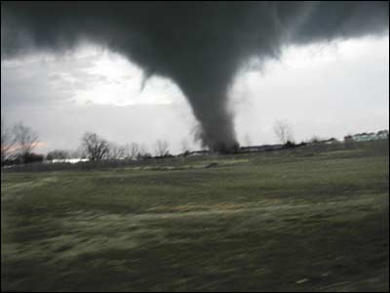
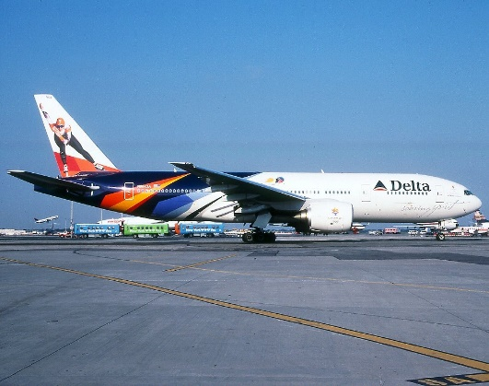
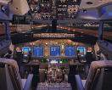
What do these two have in common?
Tornado
Boeing 777
Highly nonlinear, complicated dynamics!
Both are capable of transporting goods and people over long distances
BUT
One is controlled, and the other is not.
Control is “the hidden technology that you meet every day”
It heavily relies on the notion of “feedback”

Slide 8
What is a Control System?
Control is the process of making a system variable adhere to a particular value, called the reference value.
Traffic Lights
Train Networks
Microwave
Lifts
Automatic Doors
Burglar Alarm
Air Conditioning Systems
Security Lights
Robots
Theme Park Rides

Slide 9
Steering
Brakes
Anti-skid
Wipers
Mirrors
Cruise control
GPS
Radio
Traction control
Shifting
Headlights
Electronic ignition
Temperature control
Seats
Electronic fuel injection
Seatbelts
Bumpers
Fenders
Suspension (control)
Airbags

Slide 10
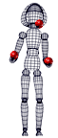
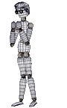
Control is Every where
Mechatronics
Industrial Automation
Robotics
Electromechanical Systems
Micro Electro Mechanical Systems (MEMS)
Nano Electro Mechanical Systems (NEMS) : Nano Technology
Sensors and Transducers

Slide 11
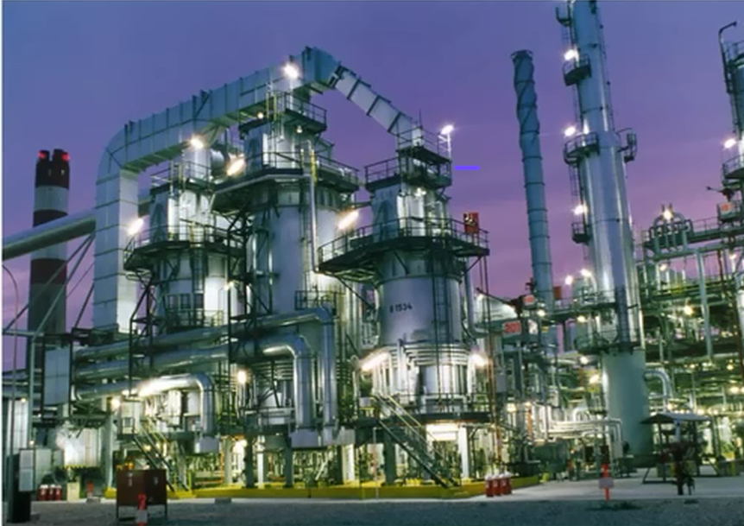
Process Industry

Slide 12
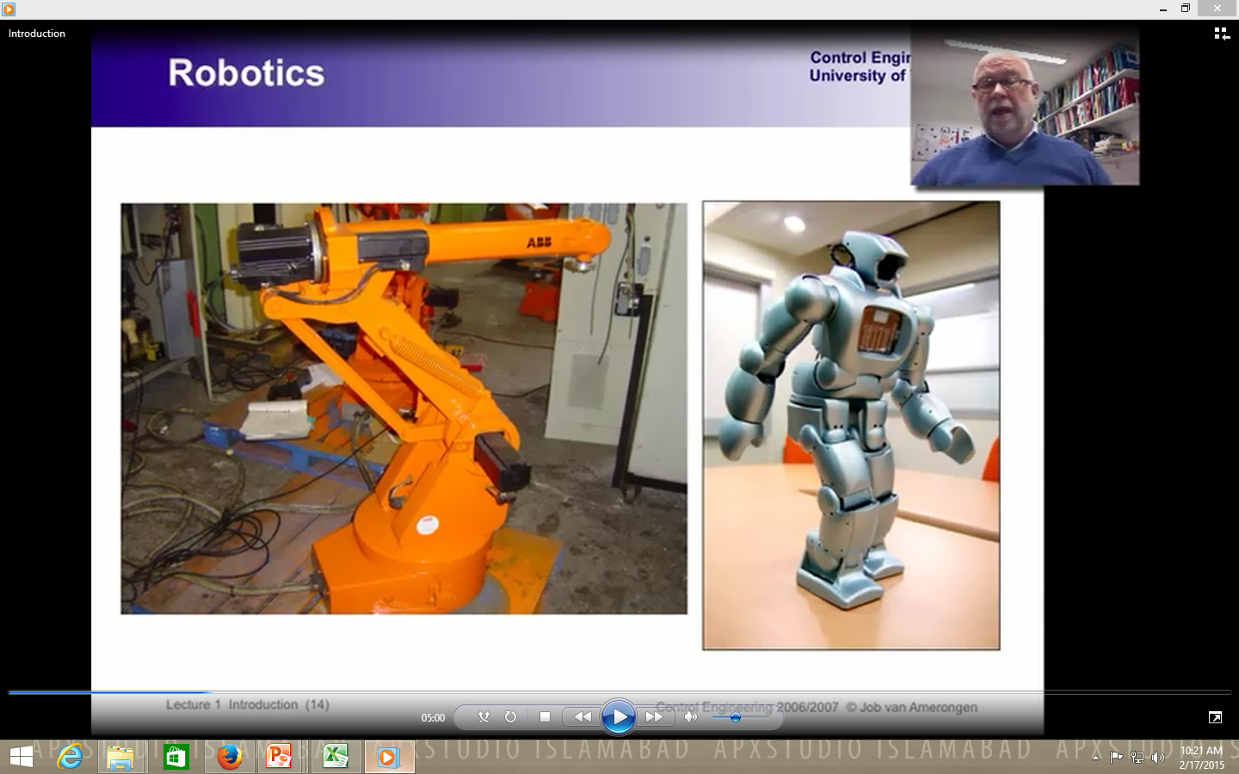
Robotics

Slide 13
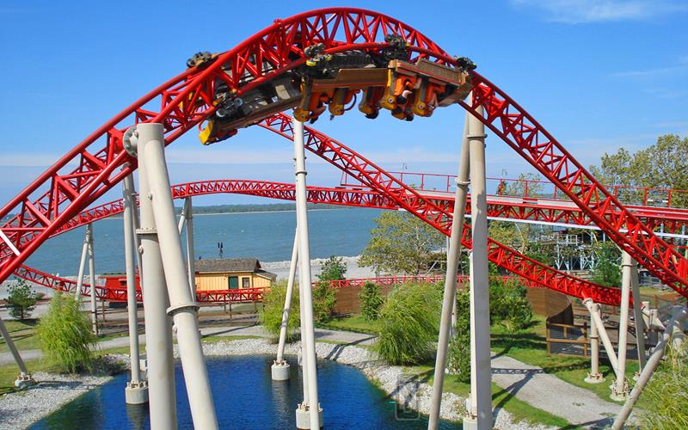
Theme Park Rides

Slide 14
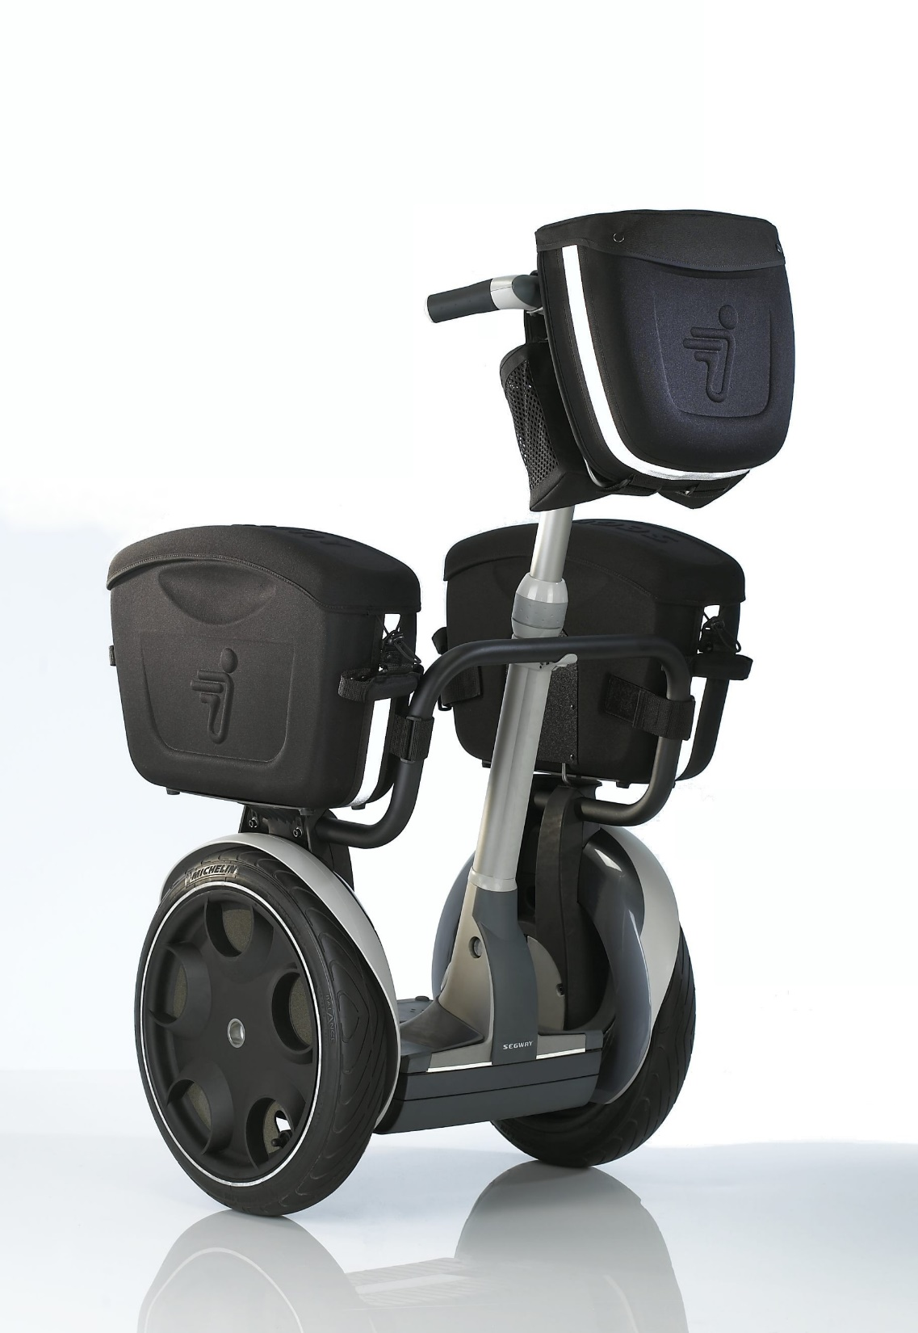
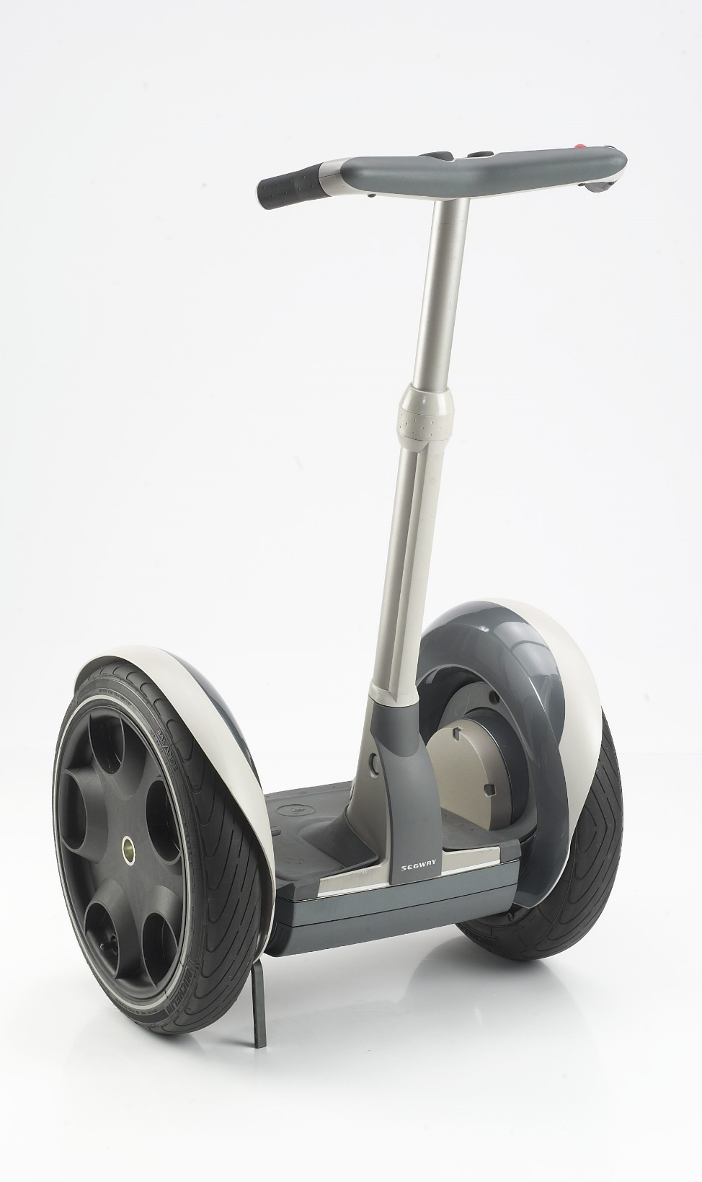
Segway: The human Transporter

Slide 15
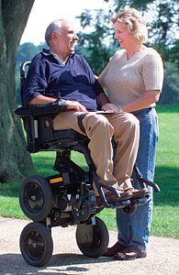
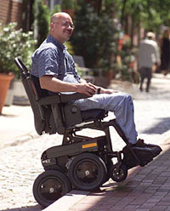
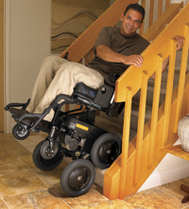

Slide 16
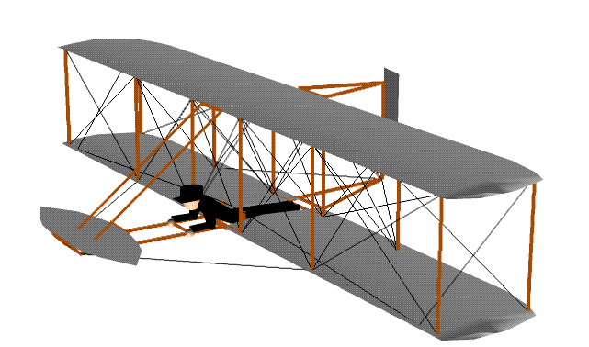
Control is Every where
FLY BY WIRE
OR
MORE ELECTRICAL AIRCRAFT
Notes:
Fly-by-wire (FBW) is a system that replaces the conventional manual flight controls of an aircraft with an electronic interface. The movements of flight controls are converted to electronic signals transmitted by wires (hence the fly-by-wire term), and flight control computers determine how to move the actuators at each control surface to provide the ordered response.

Slide 17

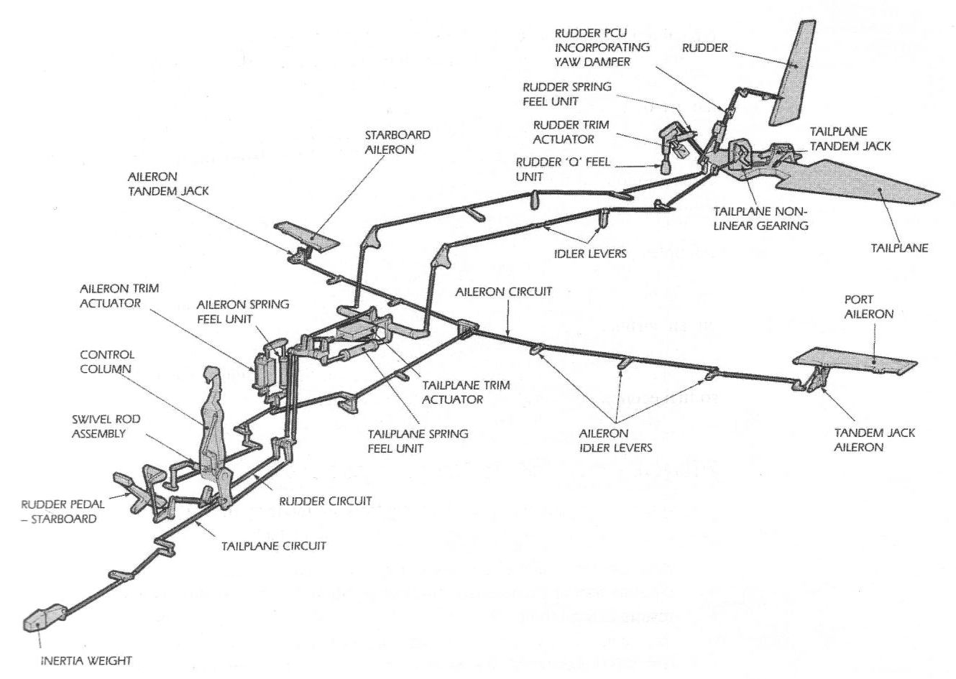
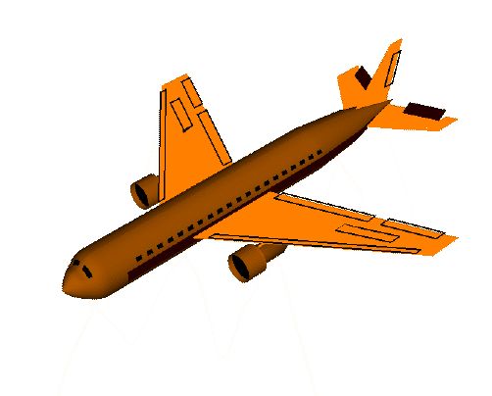


Pilot Input : Mechanical
Mechanical Transmission
Fly
BY
Wire
Output :Mechanical
OR
More
Electrical
Aircraft

Slide 18
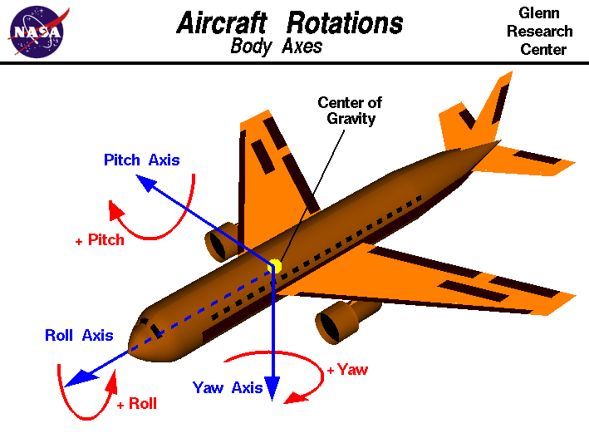

Slide 19
